Slide 1
VIDEO STREAMING
USING DJANGO

Slide 2

INTRO
The website is designed with a responsive interface to ensure optimal user experience variety kind of videos across different devices. Scalability and performance optimization techniques will be implemented to handle increased traffic and concurrent video streams.

Slide 3
REQUIREMENTS
To set up video streaming using Django, you will need a Django web application with appropriate models and views, a compatible video codec, a media server or storage for video storage and retrieval, and a video player implementation in HTML/CSS/JavaScript to handle streaming playback.

Slide 4
REQUIREMENTS
User Registration and Authentication - Users should be able to create accounts, log in, and manage their profiles. Implement secure authentication mechanisms to protect user data and ensure authorized access to content.
Content Management - Build a robust content management system to handle video uploads, metadata, categorization, and organization. Administer tools to manage content libraries, including adding, editing, and deleting videos.

Slide 5
REQUIREMENTS
Video Upload - Provide a mechanism for administrators to upload videos to your platform. Implement video encoding and transcoding processes to convert uploaded videos into suitable formats for streaming.
Search and Filtering - Enable users to search for videos based on titles ,description, or other relevant criteria. Implement filters to refine search results and make it easy for users to find specific content.

Slide 6
REQUIREMENTS
Responsive Design - Develop a responsive and user-friendly interface that adapts to different screen sizes and devices. Ensure a seamless experience across desktops, tablets, and mobile devices.
Scalability and Performance - Design your application architecture to handle increased traffic and concurrent video streams. Employ techniques like caching, load balancing, and database optimization to ensure optimal performance.

Slide 7
FEATURES
The features for video streaming using Django include seamless integration with Django's web framework, support for adaptive bitrate streaming, secure content delivery, user authentication and access control, and flexible customization options for a tailored video streaming experience.

Slide 8
FEATURES
User Creation - This feature allows users to create an account on the video streaming website. Users will provide necessary details such as username, email, address and password to register and gain access to the platform's features.
Add and Remove from Favourites - Users can add videos to their favourites list. They can also remove videos from their favourites list if they no longer wish to keep them there.

Slide 9
FEATURES
Upcoming Updates - This feature informs users about upcoming updates, new video releases, or any changes happening on the platform. It helps keep users informed and engaged with the latest content and enhancements.
Search Videos - Users can search for specific videos using keywords, titles, genres, or other relevant criteria. This functionality provides a convenient way for users to find the content they are interested in quickly.

Slide 10
FEATURES
Profile Management - Users have the ability to provide feedback about the website. They can share their opinions, suggestions, or report any issues they encounter, helping the website owners improve the platform based on user feedback.
User Feedback - Users can engage in discussions by adding comments to videos. They can share their thoughts, ask questions, or provide feedback about specific videos, fostering community interaction and user engagement.

Slide 11
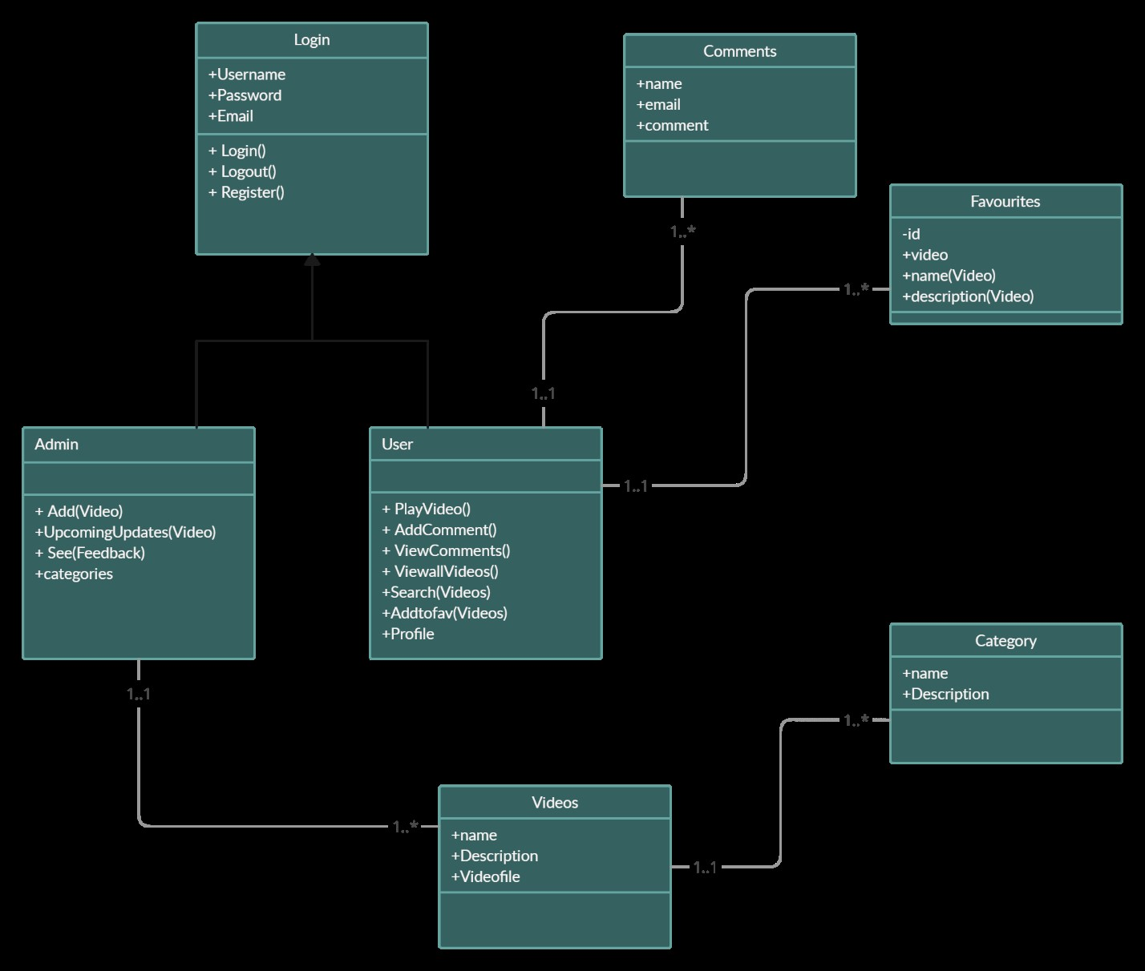
Class diagram

Slide 12
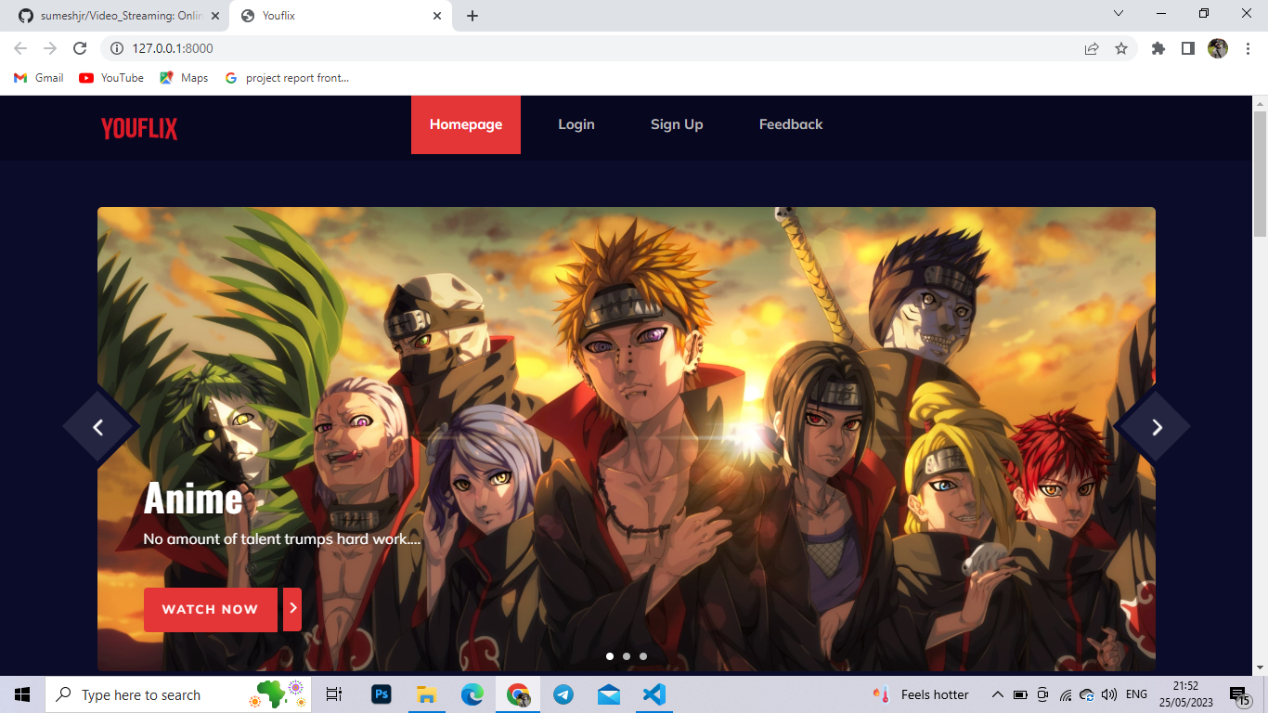
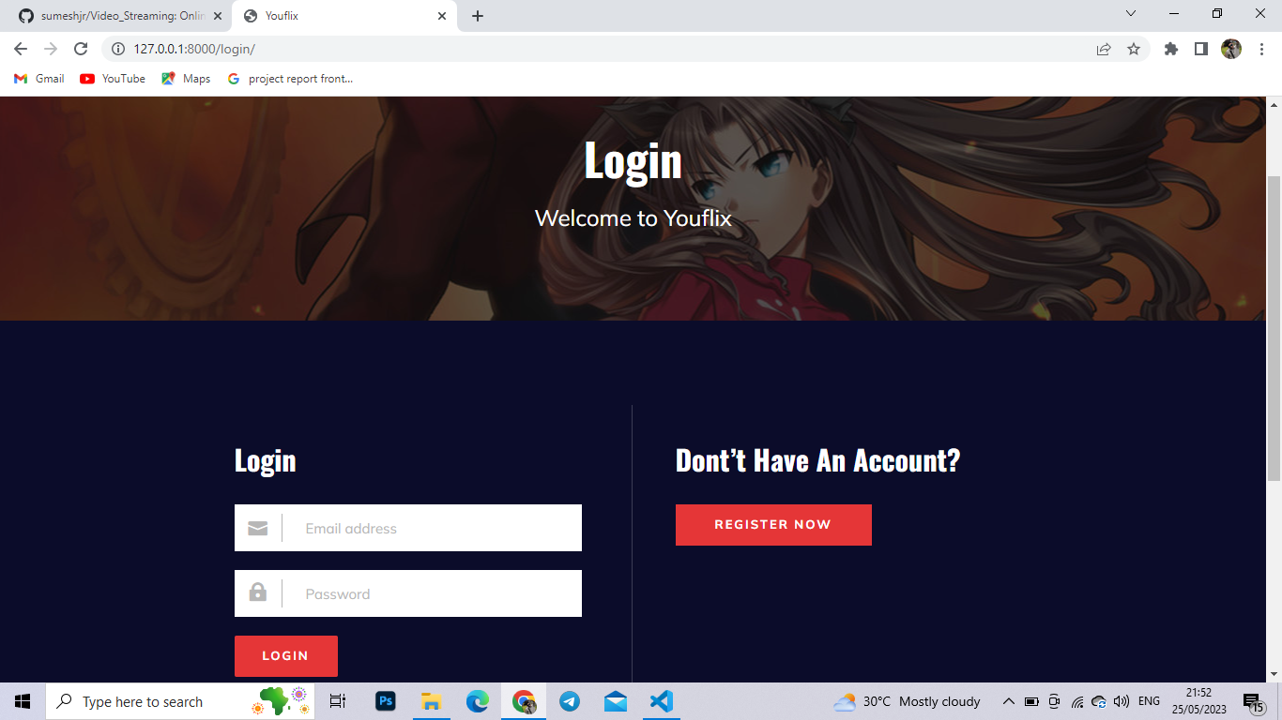
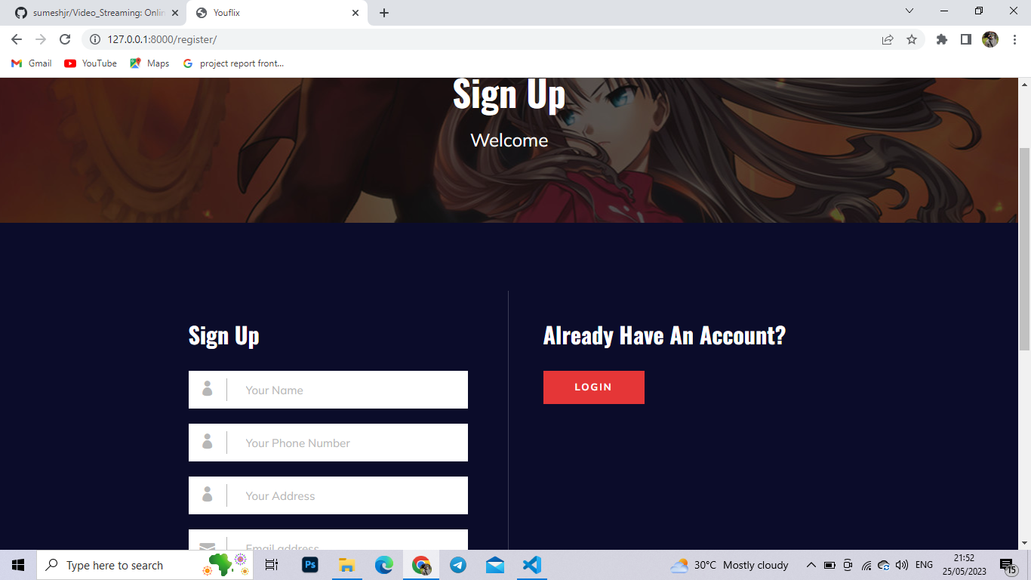
SCREENSHOTES
HOME
LOGIN
REGISTER

Slide 13
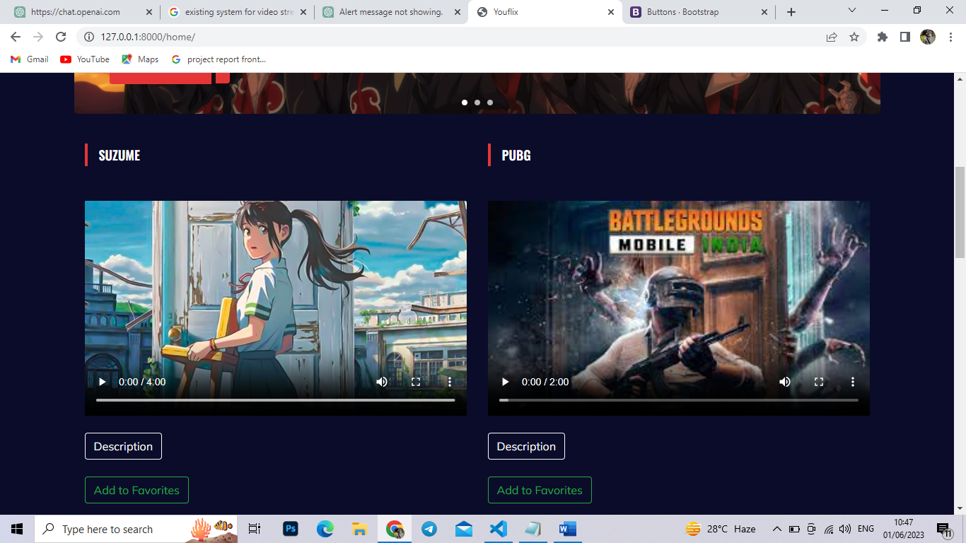
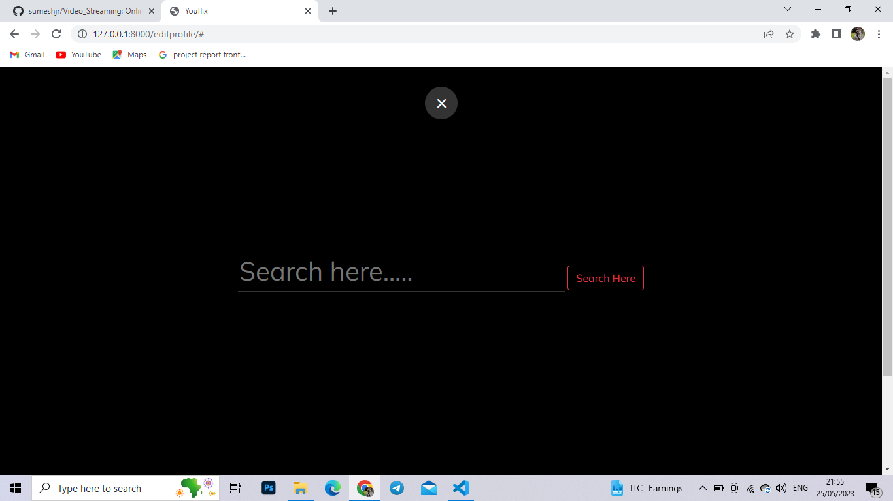
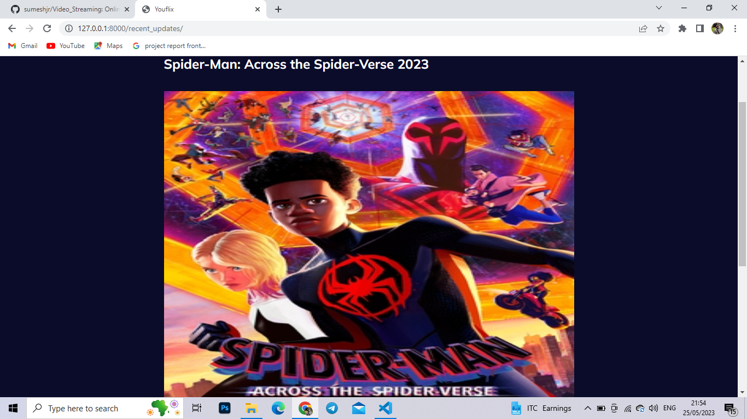
SCREENSHOTES
ADD TO FAV
SEARCH BAR
UPCOMING UPDATES

Slide 14
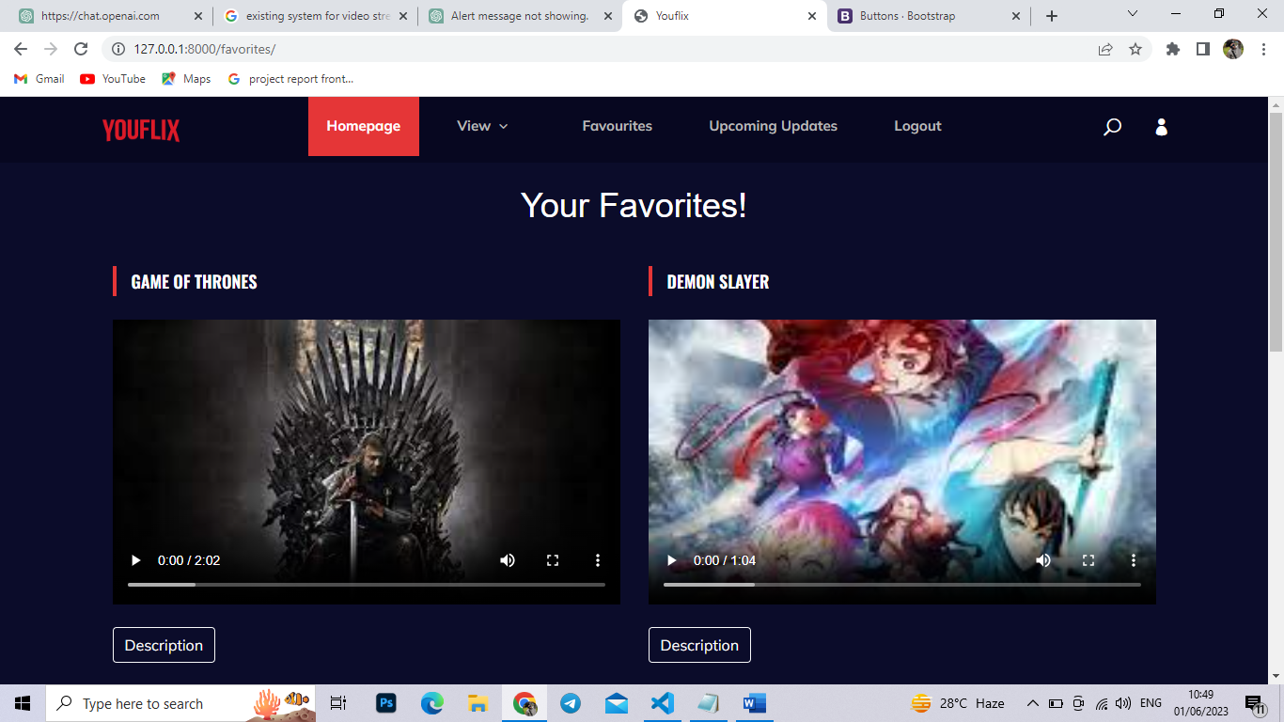
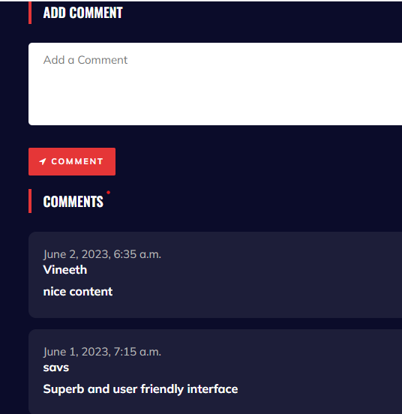
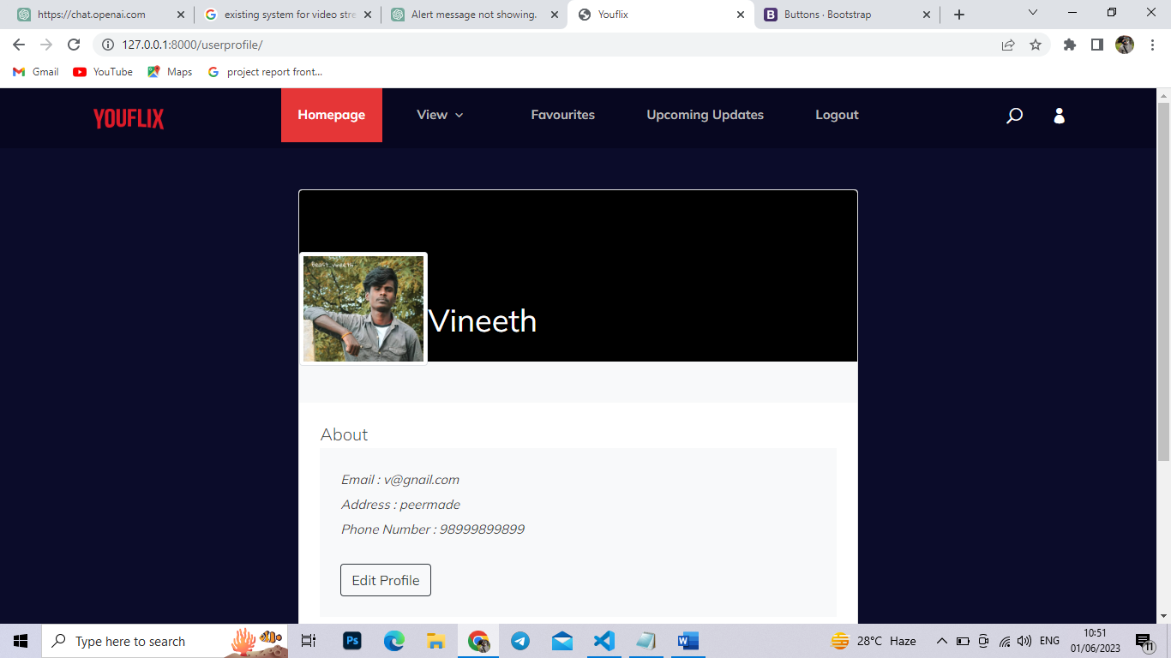
SCREENSHOTES
FAVOURITES
COMMENT BOX
User profile

Slide 15
CHALLENGES
Video Encoding
One of the primary challenges is efficiently delivering video content to users. Video files tend to be large, which can lead to slow streaming or buffering issues.
Optimization
Video streaming websites require optimization to ensure fast loading times and a smooth user experience.
Authentication
Building a secure authentication and authorization system is critical for a video streaming website. Users should be able to create accounts, manage their permissions.
As your user base grows, scalability becomes crucial. Handling a large number of concurrent video streams and serving them efficiently requires careful architecture and optimization.
Scalability

Slide 16
FUTURE ENHANCEMENTS
 | Personalized Recommendations
 | Live Streaming
 | Multi-language and Subtitles
 | Live Chat and Interactive Features:
 | Virtual Reality (VR) and 360° Video

Slide 17

CONCLUSION
In conclusion, developing a video streaming website using Django offers numerous opportunities to create a compelling platform for delivering video content. However, it also comes with its own set of challenges and considerations.
Overall, with careful planning, technical expertise, and attention to user needs, you can create a successful and innovative video streaming website using Django that delivers high-quality content to a wide range of viewers

Slide 18
THANK YOU
SUMESH J
22PMC160

